Slide 1
Chapter 3 – Computational optimization of the elastic wave-equation
Random boundaries

Slide 2
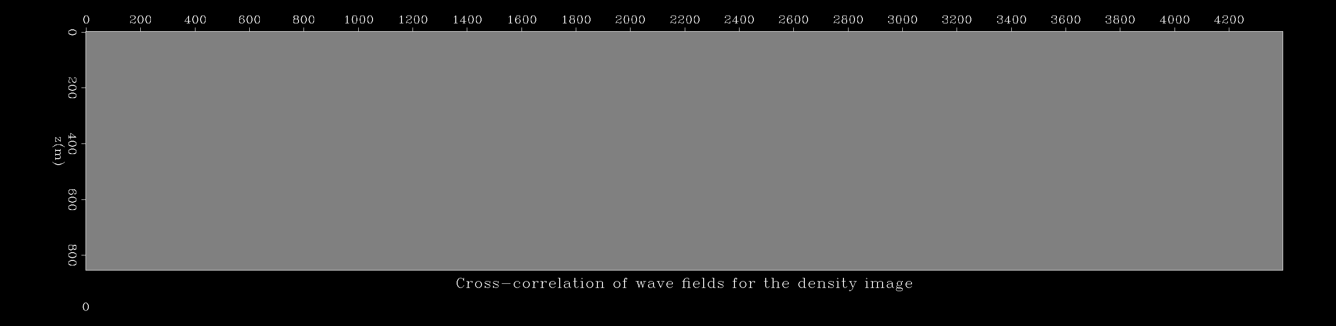
Chapter 3 – Reducing memory costs
Forward propagation
Backward propagation
Straightforward solution? Store in memory the forward wavefield.
Problem? It requires A LOT of memory!
Around 150 Gb for 10 seconds of data in a 2D 1000x1000 grid.

Slide 3
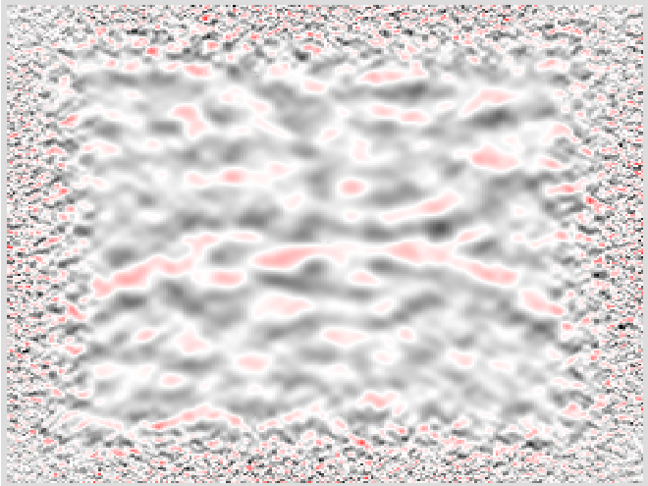
Chapter 3 – Random boundaries
Random model example:

Slide 4

Chapter 3 – Random boundaries
Forward propagation of the pressure wavefield

Slide 5
Chapter 3 – Random boundaries
Last time step of the pressure wavefield

Slide 6
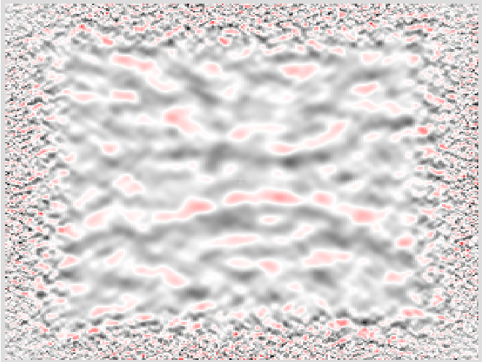
Chapter 3 – Random boundaries
Penultimate time step of the pressure wavefield

Slide 7
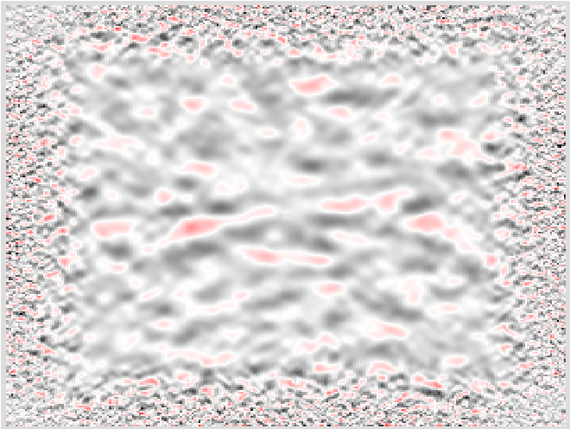
Chapter 3 – Random boundaries
Backward propagation of the pressure wavefield

